Slide 1
Paediatric Advanced Life Support Workshop November 2024
Presentation and delivery by:
Dr Rebecca Zhao FANZCA

Slide 2
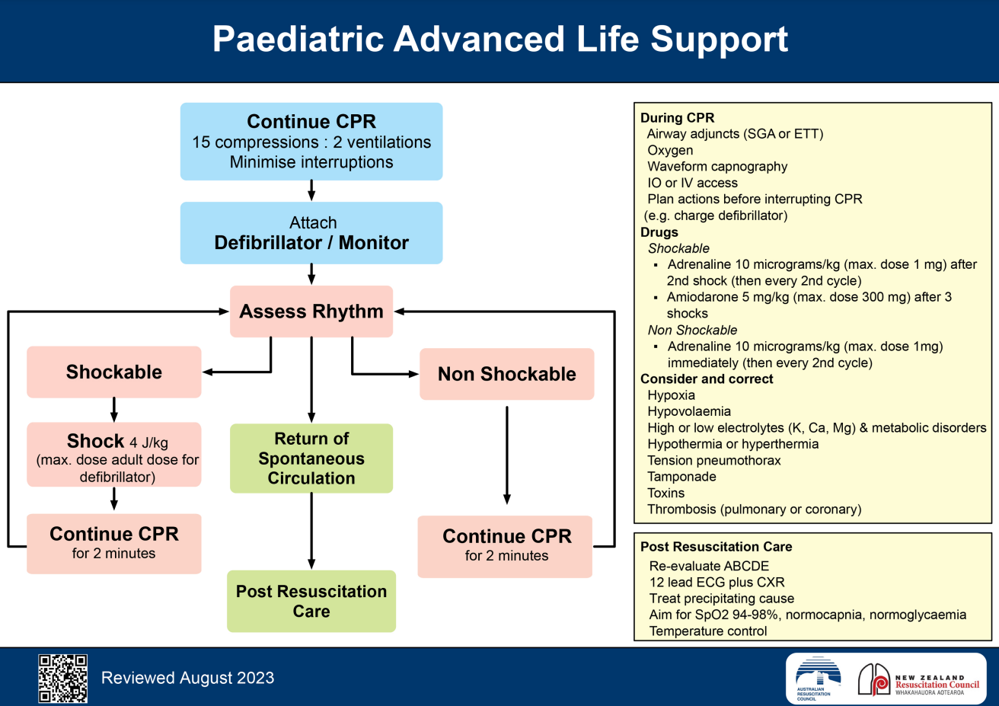

Slide 3
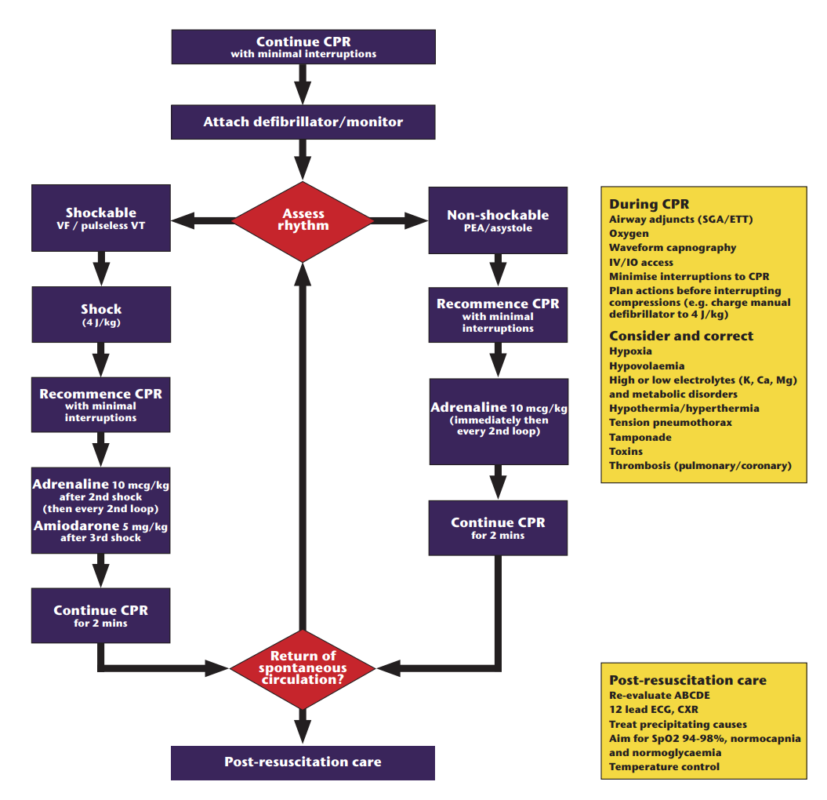

Slide 4
Differences between Paediatric & Adult Arrest
What are the most common causes of arrest in Paediatric population
In the paediatric population, cardiorespiratory arrest is more often secondary to respiratory (e.g. hypoxaemia secondary to respiratory infection, trauma, drowning or poisoning) or circulatory failure (e.g. hypotension secondary to septicemia or trauma) rather than a primary arrest from an arrhythmia.
What % of paediatric arrest presents with shockable rhythm?
The initial cardiac rhythm discovered is usually (85%) asystole or PEA.
The incidence of VF or pulseless VT as the initial rhythm is approximately 15%.⁸ More likely to be associated with:
Congenital heart conditions
Poisoning with cardioactive medications and
Membrane ion channelopathies such as congenital long QT syndrome.
Notes:
Cardiorespiratory arrest may occur as the end result of a wide variety of conditions in infants and children. In the paediatric population, cardiorespiratory arrest is more often secondary to respiratory (eg. hypoxaemia secondary to respiratory infection, trauma, drowning or poisoning) or circulatory failure (eg. hypotension secondary to septicemia or trauma) rather than a primary arrest from an arrhythmia.
The initial cardiac rhythm discovered is usually (85%) asystole or PEA.⁸ The incidence of ventricular fibrillation or pulseless ventricular tachycardia as the initial rhythm is approximately 15%.⁸ Ventricular fibrillation may be present more commonly as the initial presenting rhythm in association with congenital heart conditions, poisoning with cardioactive medications and membrane ion channelopathies such as congenital long QT syndrome. When ventricular fibrillation is encountered later in the course of resuscitation, it is more likely to represent an agonal rhythm. Respiratory arrest may occur alone, but if not treated promptly, it may rapidly progress to cardiac arrest.

Slide 5
When to use which algorithm?
When to use the APLS Algorithm?
For the purposes of paediatric life support guidelines, paediatric patients include infants (0 to 12 months of age ie. up to the first birthday), and children (up to the 18th birthday), excluding newborns.
Infants aged more than a few hours beyond birth should be managed according to paediatric guidelines (with a compression-ventilation ratio of 15:2) in the pre-hospital, emergency department, paediatric inpatient and paediatric intensive care unit environments.
Notes:
When should you switch from neonatal to paediatric life support algorithm
And then when to switch from paediatric to adult life support algorithm
Definitions of ‘newborn’, ‘infant’ and ‘child’ are based on combinations of physiology, age and physical size which influence the efficacy and practicality of performing resuscitative techniques.
The term ‘newborn’ refers to an infant at the time of birth.
From a practical perspective,
- If the rescuer believes that the patient is a child, then they should follow paediatric guidelines and adult guidelines should be used for anyone who appears to be an adult. If the patient turns out to be a young adult, it is unlikely that any harm will have been done as the paediatric pattern of cardiorespiratory arrest has been demonstrated to continue into early adulthood.⁷
- The exact age at which paediatric techniques, particularly the compression-ventilation ratio, should replace those used for newborns is not certain, especially for small premature infants. Infants whose cardiorespiratory physiology is in transition from an intra-uterine environment at birth to several hours after birth (ie. newborns) should preferably be managed as per neonatal guidelines (Section 13). Infants aged more than a few hours beyond birth should be managed according to paediatric guidelines (with a compression-ventilation ratio of 15:2) in the pre-hospital, emergency department, paediatric inpatient and paediatric intensive care unit environments.⁶

Slide 6
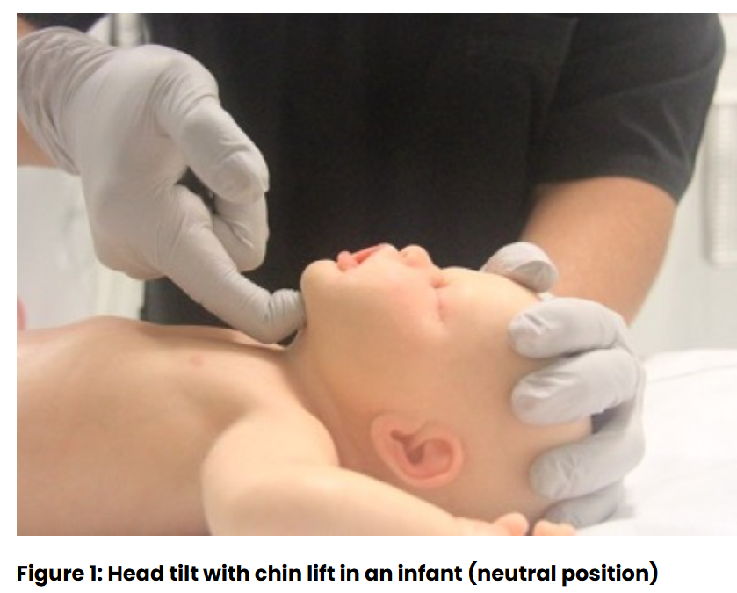
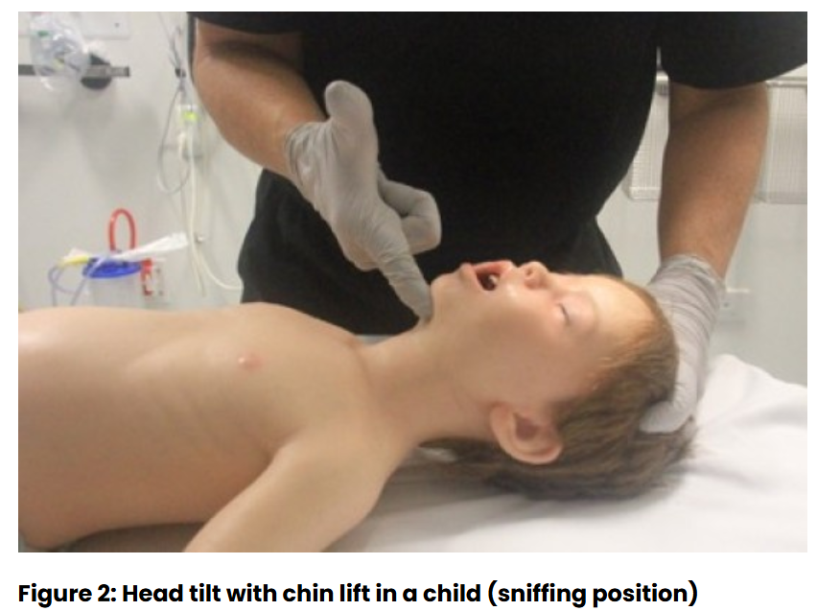
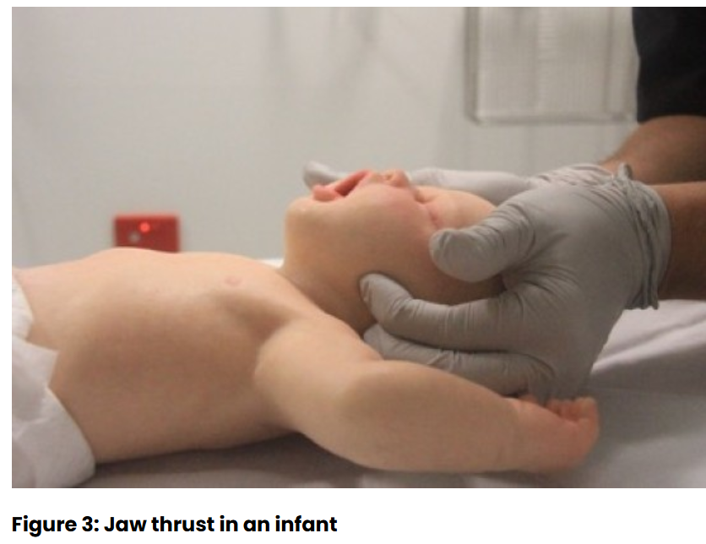
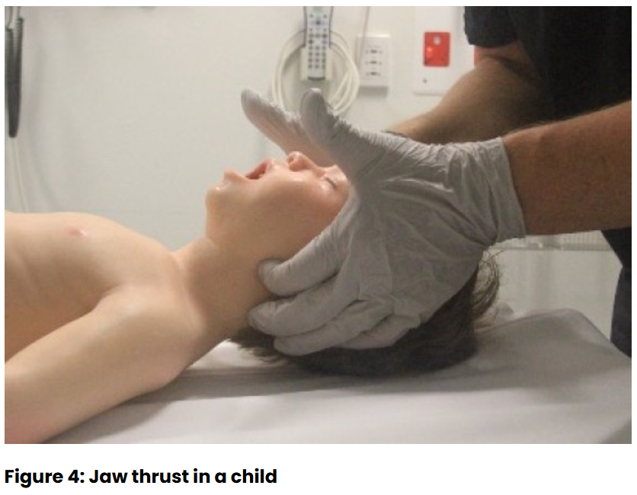
Differences between Paediatric & Adult Life Support
Airway
Airway opening manoeuvre
Insertion of OPA
Notes:
Airway opening manoeuvres may be used to optimise the position of the infant’s (neutral) or child’s (‘sniffing position’ ie. mild extension of head on neck and mild flexion of neck on shoulders) airway. Hyperextension of the neck should be avoided as it may cause airway obstruction, especially in small infants. If a neck injury is suspected, only jaw thrust should be used [Good Practice Statement] to avoid worsening the injury.

Slide 7
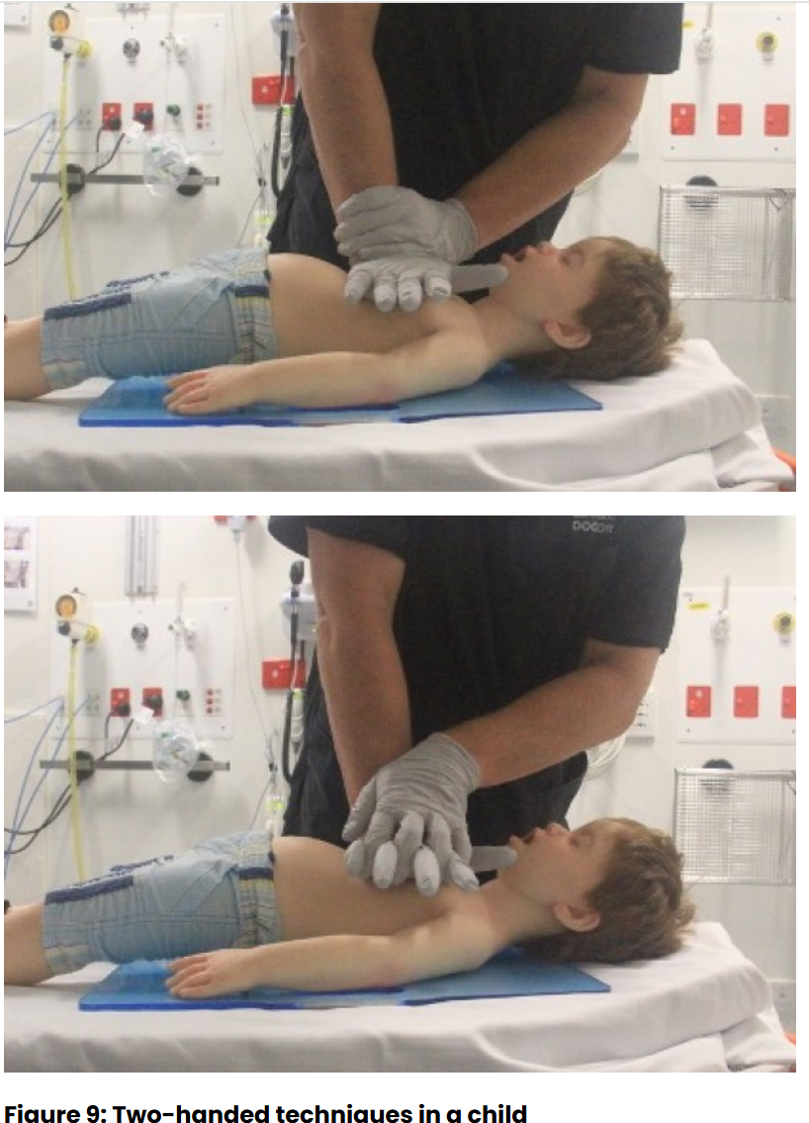
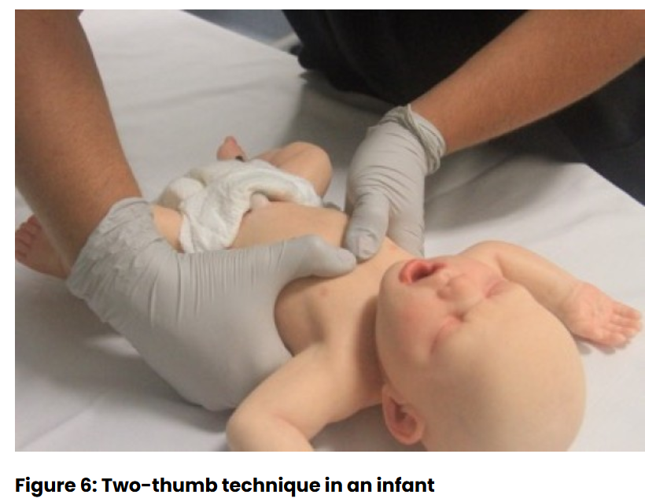
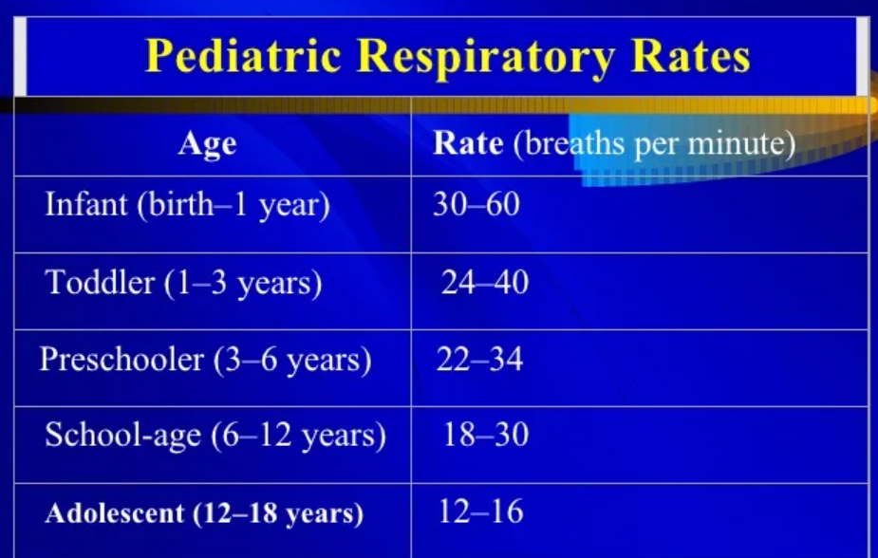
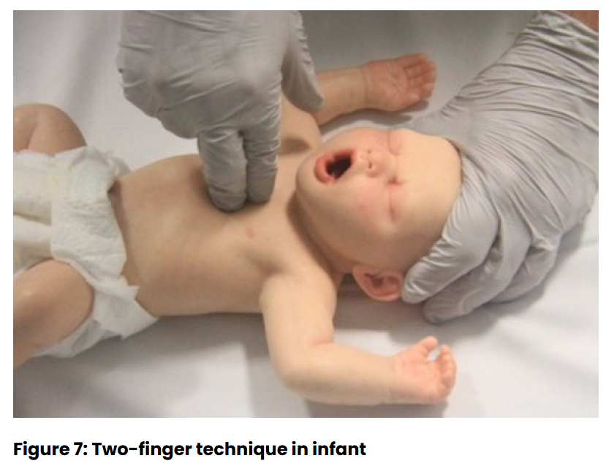
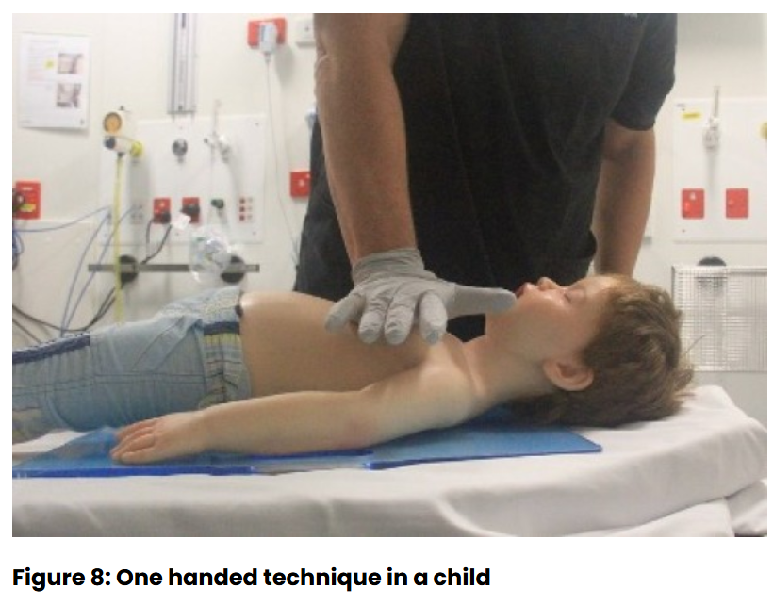
Differences between Paediatric & Adult ALS
Breathing
CPR: Ventilation ratio (15:2)
Consider 2 Breaths before CPR
Circulation
Compression technique and depth
Ventilation rate with advanced airway
IO – antero-medial surface of proximal/distal tibia most suitable during resus of infants & children
Notes:
ANZCOR suggests that two initial ventilations should be provided before commencement of external cardiac compressions because asphyxial causes are more common than cardiac causes in paediatric cardiorespiratory arrest [Good Practice Statement]. In circumstances where the usual equipment used to provide ventilations (eg. BVM) is not immediately available, CPR should be commenced immediately with chest compressions. No evidence the outcome is better.
ANZCOR suggests that rescuers compress the chest by at least one third the anteroposterior dimension, or approximately 4cm in an infant and 5cm in a child
In adults ANZCOR recommends ventilation rate of 6 ventilations per minute is associated with adequate oxygenation and better haemodynamics than ≥12 ventilations per minute.
There was no new evidence identified to support any specific ventilation rate for the infant or child. A reduction in minute ventilation to less than baseline for age is reasonable to provide sufficient ventilation to maintain adequate ventilation-to-perfusion ratio during CPR while avoiding the harmful effects of hyperventilation. There are insufficient data to identify the optimal tidal volume or respiratory rate

Slide 8
Differences between Paediatric & Adult ALS
Drug doses
Adrenaline 10microg/kg (max 1mg)
Amiodarone 5mg/kg (max 300mg) in 20mLs of 5% glucose
Magnesium (for torsades) 0.1- 0.2mmol/kg
Reversible causes
Hypovolaemia - 0.9% Na Chloride 10-20mL/kg
LA toxicity – Intralipid 1.5mL/kg over 1min, then Infusion 15mL/kg/hr +/- additional bolus (max 12mL/kg)
Narcosis - Naloxone 10mcg/kg (max 200-800microg)
Hypoglycaemia – 10% Glucose 2mL/kg
TCA overdose – NaHCO3 1mmol/kg
Hyperkalaemia – 10% CaCl 0.2mL/kg, insulin infusion 0.1unit/kg + 10% glucose 5mL/kg, Nebulised salbutamol 2.5-5mg
Notes:
How do you draw up adrenalin.
20kg

Slide 9
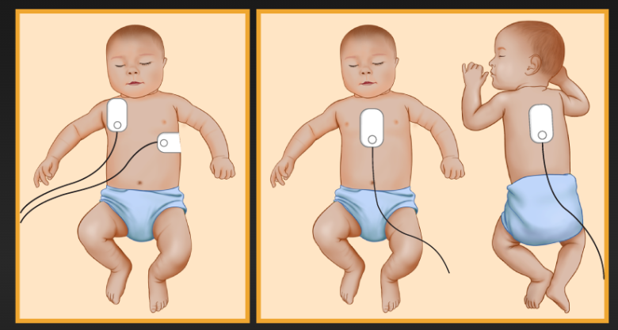
Differences between Paediatric & Adult ALS
Defibrillation
4J/kg – choose the closet level to the dose
Pad positioning/size – Manual, AED
Family presence
Notes:
ANZCOR suggests that self-adhesive defibrillation pads be used in infants and children in cardiac arrest. The largest size pads that fit an infant’s or child’s chest without touching each other should be used.¹
AED with dose attenuator
- For children older than 8 years, a standard AED with adult pads and dose may be used.
- In children 1 to 8 years, an AED with paediatric pads and/or paediatric dose attenuation is preferred. If that is not available, a standard AED with adult pads and dose may be used.
Family members should be kept closely informed of events. They should be provided the opportunity (but not coerced) to be present at the resuscitation of their child. A staff member should be assigned to be with them and support them during the process. If family presence is negatively affecting the performance of the resuscitation by healthcare personnel, the family may sensitively be asked to leave.

Slide 10
Paediatric ALS Scenario
You extubate a 3yo boy (18kg) deep following routine elective Tonsillectomy & Adenoidectomy and take them to PACU. You handover to the PACU nurse and go back to theatre. A few minutes after you leave PACU, you hear the emergency buzzer for the child. You run back to PACU.
You find the child still in recovery position, the nurse is frazzled and stating she can’t see the child breathing and cannot get a saturation reading. The child looks blue and you cannot see a sats trace or blood pressure reading.
Please manage the situation.
Notes:
D
R
S – Send for help, call paediatric code blue and emergency trolley
A – Look in airway +/- secretion/blood
B – BMV, Attempt to ventilate child. + Prepare to intubate (consider getting sux and prop). #4 microcuff ETT, MAC 2 blade
C – (feel for pulse). Start CPR
D – Defib pads. (PEA). Adrenalin 180microg (1.8mLs of 1:10,000) immediately.
4 H & 4Ts – likely hypoxic arrest
Say something about the family
Recognise need to manage airway early

